Slide 1
Electron diffraction
Studying crystal structure using wavelike phenomena of the electrones.
Anastasija Cumika
09 May 2018

Slide 2
Outline
Crystals’ structure
Electron diffraction theory: Wave-particle duality,Bragg’s Law
Techniques and equipment used for electron diffraction
Electron diffraction images
Limitations and advantages

Slide 3
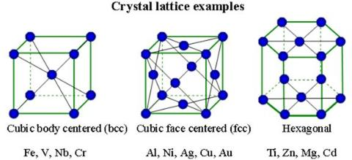
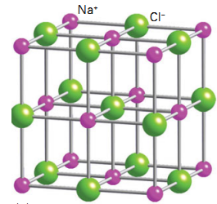
Crystals
Crystals are build of a periodic array of atoms or groups of atoms.
The spacing between the atoms are in the order of a few angstroms

Slide 4
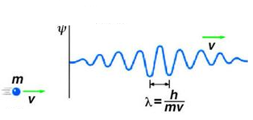
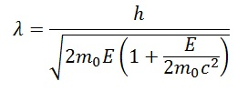
Wave-Particle duality Louis de Brogile, 1924 – matter can behave like a wave.
Electrons with bigger momentum have smaller wavelength.
To get a small wavelength, electrons are accelerated to the speed that requires relativistic approach.

Slide 5
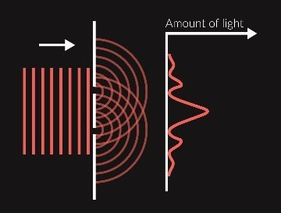
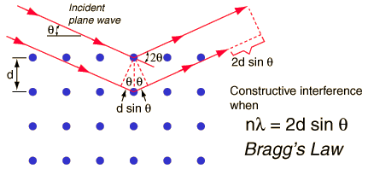
Bragg’s Law
The periodic structure of crystals acts as a diffraction grating for the electron beam causing an interference.

Slide 6
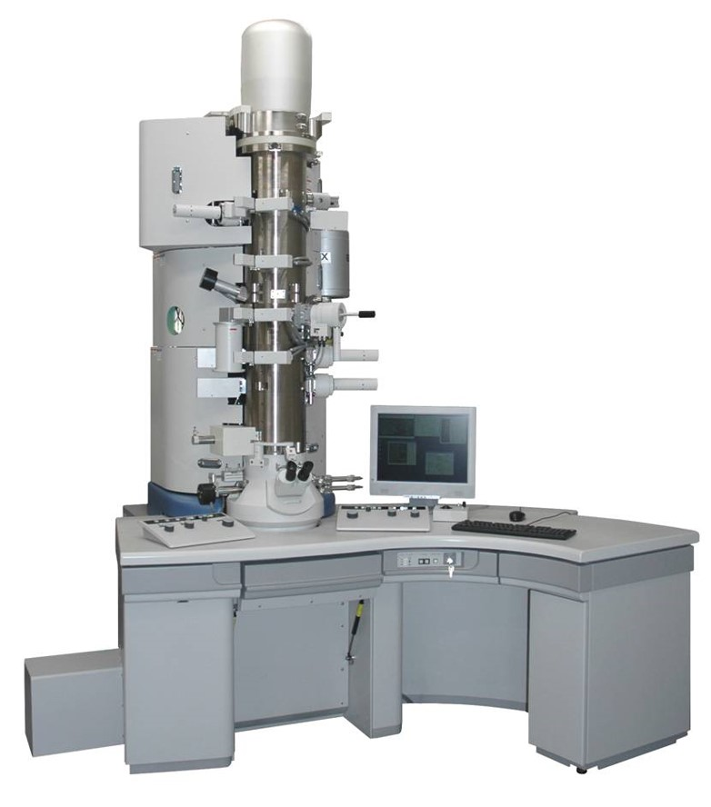
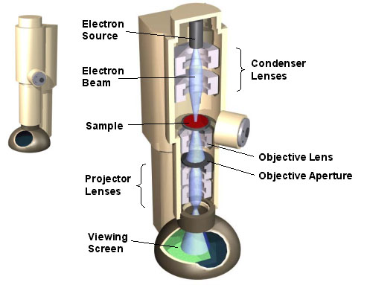
Transmission Electron Microscopy Max Knoll and Ernst Ruska,1931
Acceleration voltages 100-300 keV

Slide 7
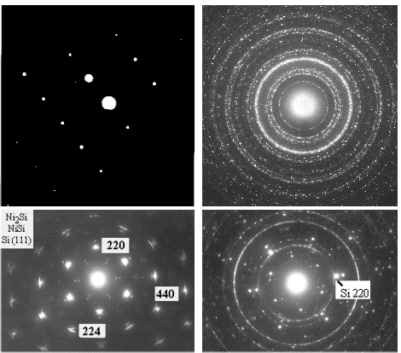
Images of electron diffraction
Diffraction patterns with an electron beam
Aluminum single crystal (Al) | Polycrystalline platinum silicide (PtSi)
Silicon with epitaxial nickel silicides ( Si - NiSi - NiSi₂) | Polycrystalline nickel mono silicide (NiSi) on top of single crystalline silicon (Si)

Slide 8
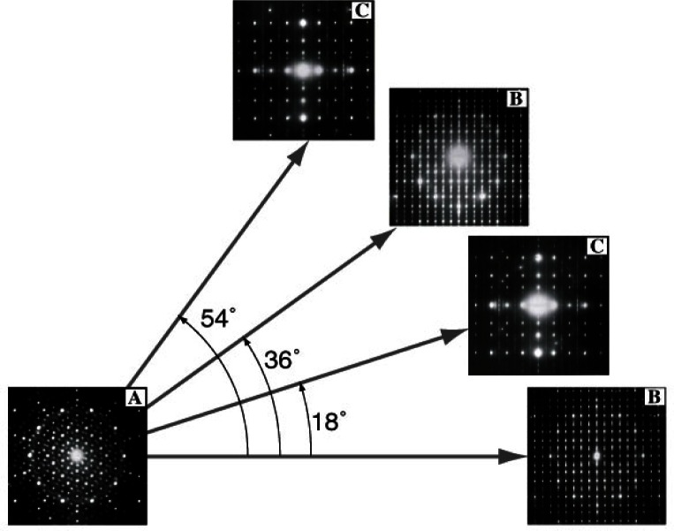
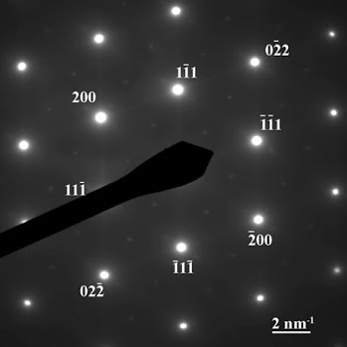
Images of electron diffraction
By tilting the sample we can observe the diffraction patterns from several crystal orientations to get the 3D image
Advanced analytical techniques used to examine solids depending on diffraction patterns

Slide 9
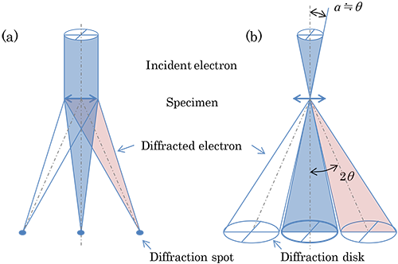
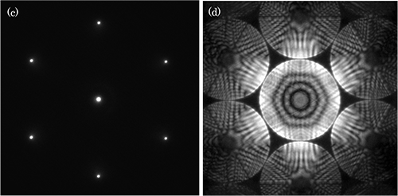
Convergent and non convergent beam of electrons
Single crystal silicone diffraction patterns

Slide 10
Advantages over X-ray Crystologrophy
Small wavelenght allows the analysis of the small crystals and protetin structures.
More flexibility because we can vary electron acceleration
No radiation damage
Electons are charged, therefore more interaction with matter.

Slide 11
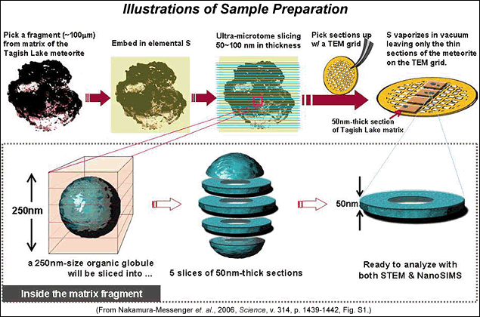
Limitations
Sample has to be very thin (<100nm), so it is electron transperant. Hard to prepare such a sample
Difraction has to be preformed in vaacum

Slide 12
References
https://www.askiitians.com/iit-jee-dual-nature-of-matter-and-x-rays/de-broglie-waves/
https://electronmicroscopist.wordpress.com/category/electron-microscopy/page/2/
https://www.quora.com/In-a-double-slit-interference-pattern-why-does-the-intensity-of-the-fringes-decrease-as-you-get-further-away-from-the-central-maximum
http://hyperphysics.phy-astr.gsu.edu/hbase/quantum/bragg.html
http://save.btsa.co/crystalline-structure/
http://barrett-group.mcgill.ca/tutorials/nanotechnology/nano02.htm
http://www.nano.pitt.edu/node/413
https://www.jeol.co.jp/en/words/emterms/search_result.html?keyword=convergent-beam%20electron%20diffraction
http://www.psrd.hawaii.edu/Jan07/organicGlobules.html
https://link.springer.com/chapter/10.1007/978-94-015-8971-0_7

Slide 13
Thank you!
Questions?

